Slide 1
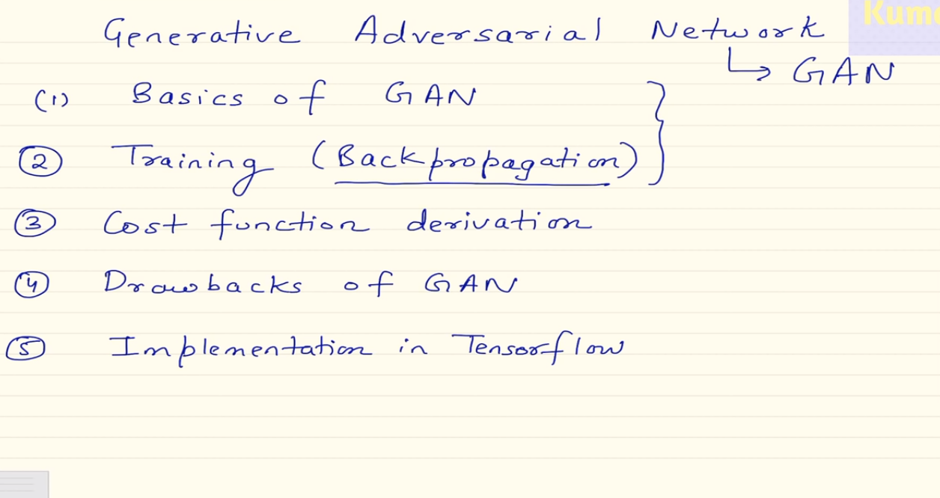

Slide 2
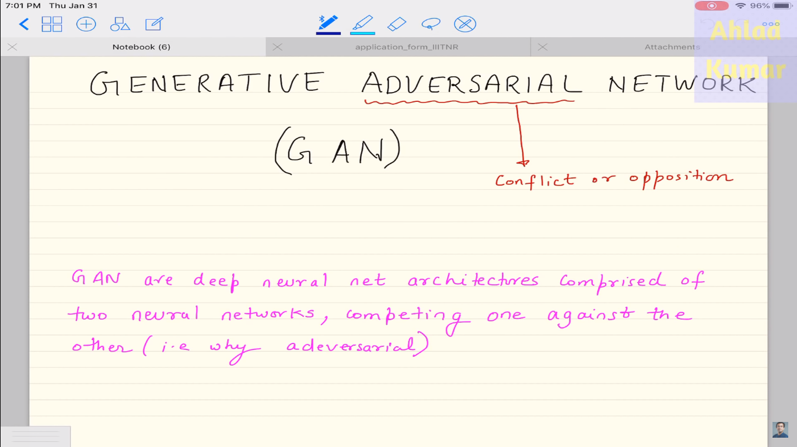

Slide 3
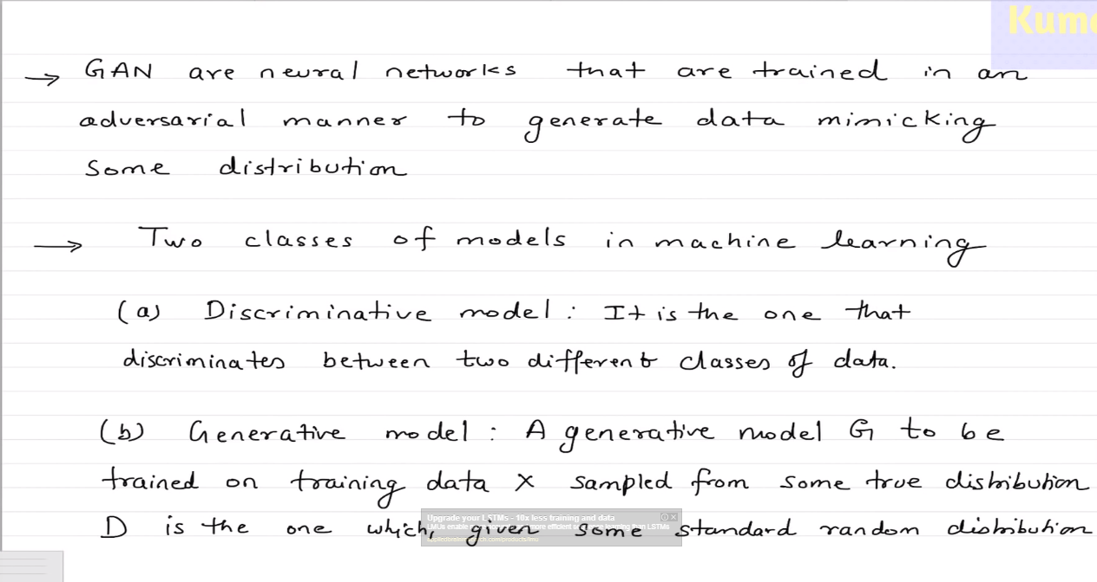
9

Slide 4
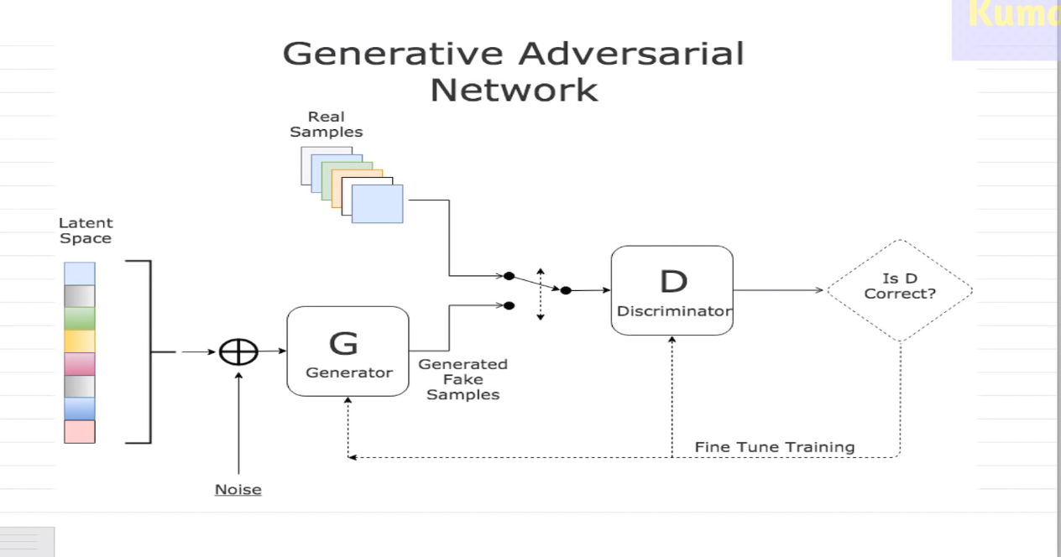

Slide 5
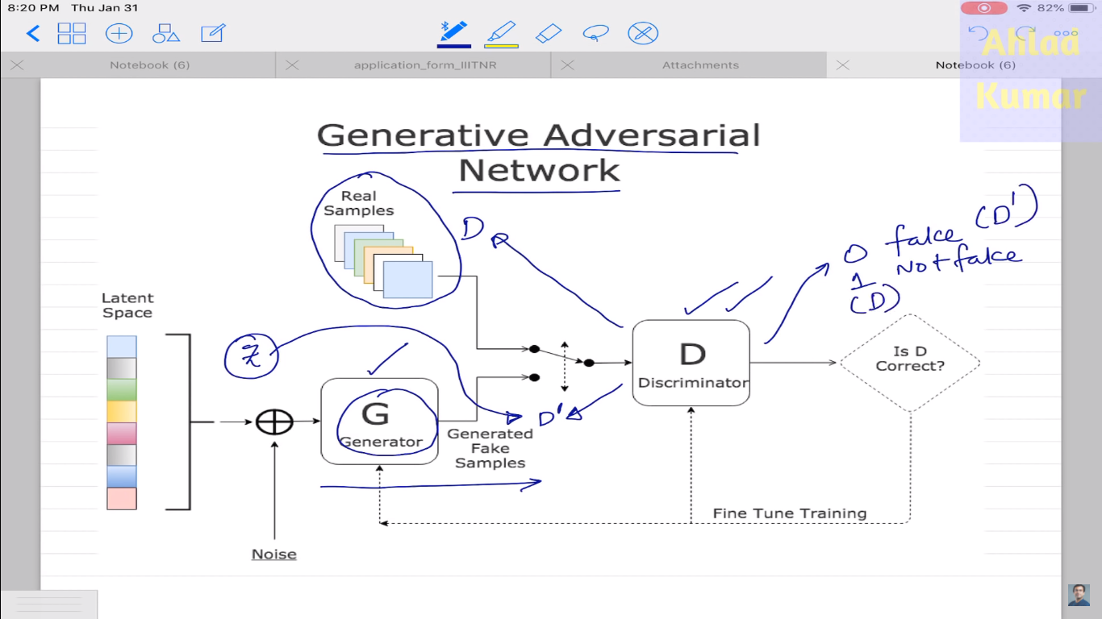

Slide 6
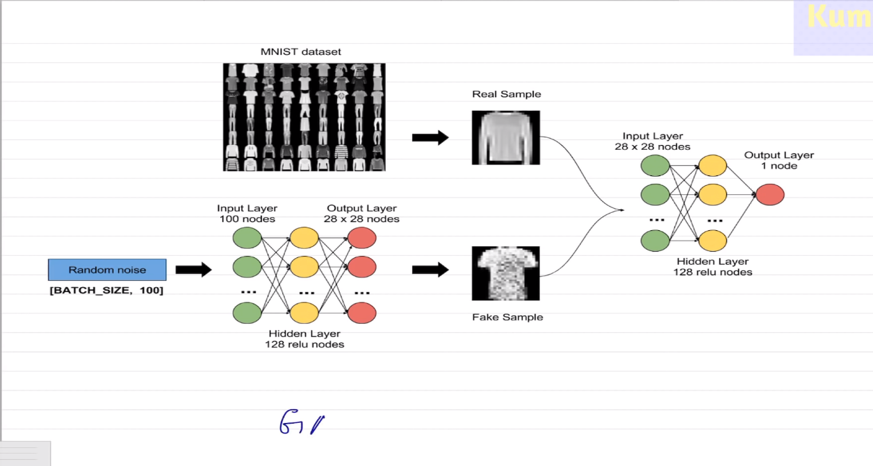

Slide 7
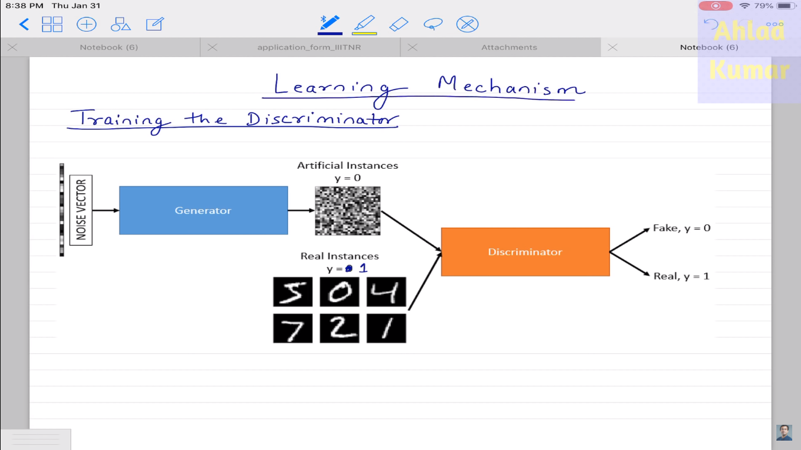

Slide 8
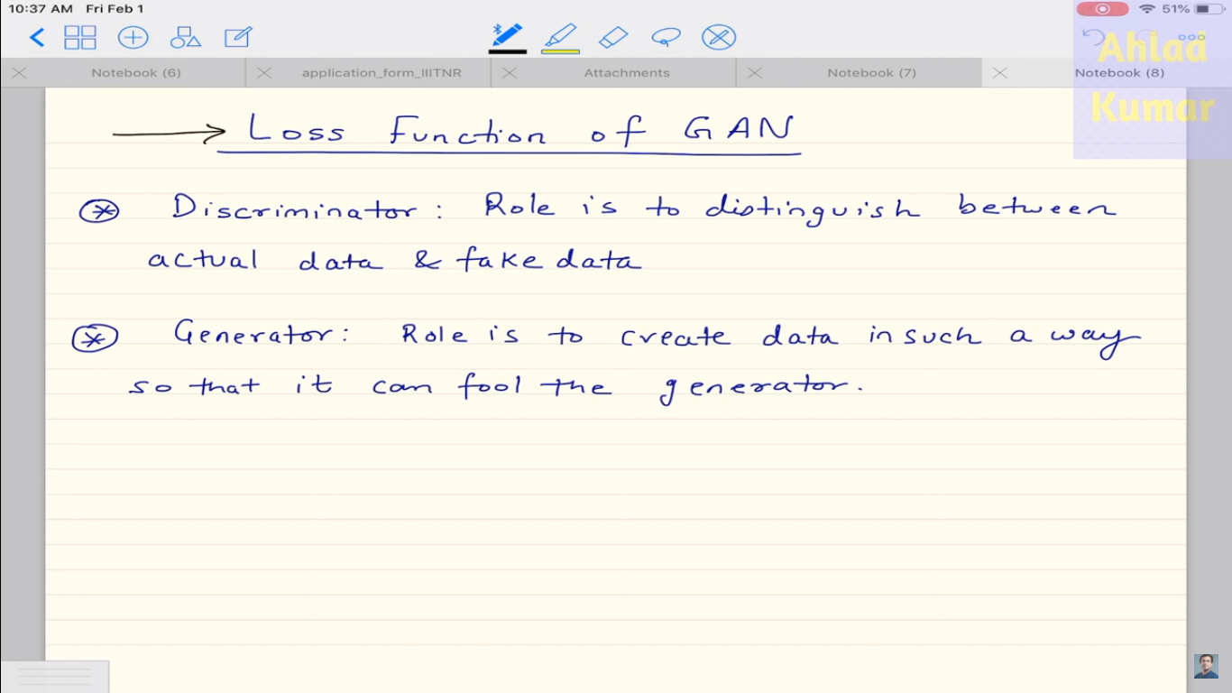

Slide 9
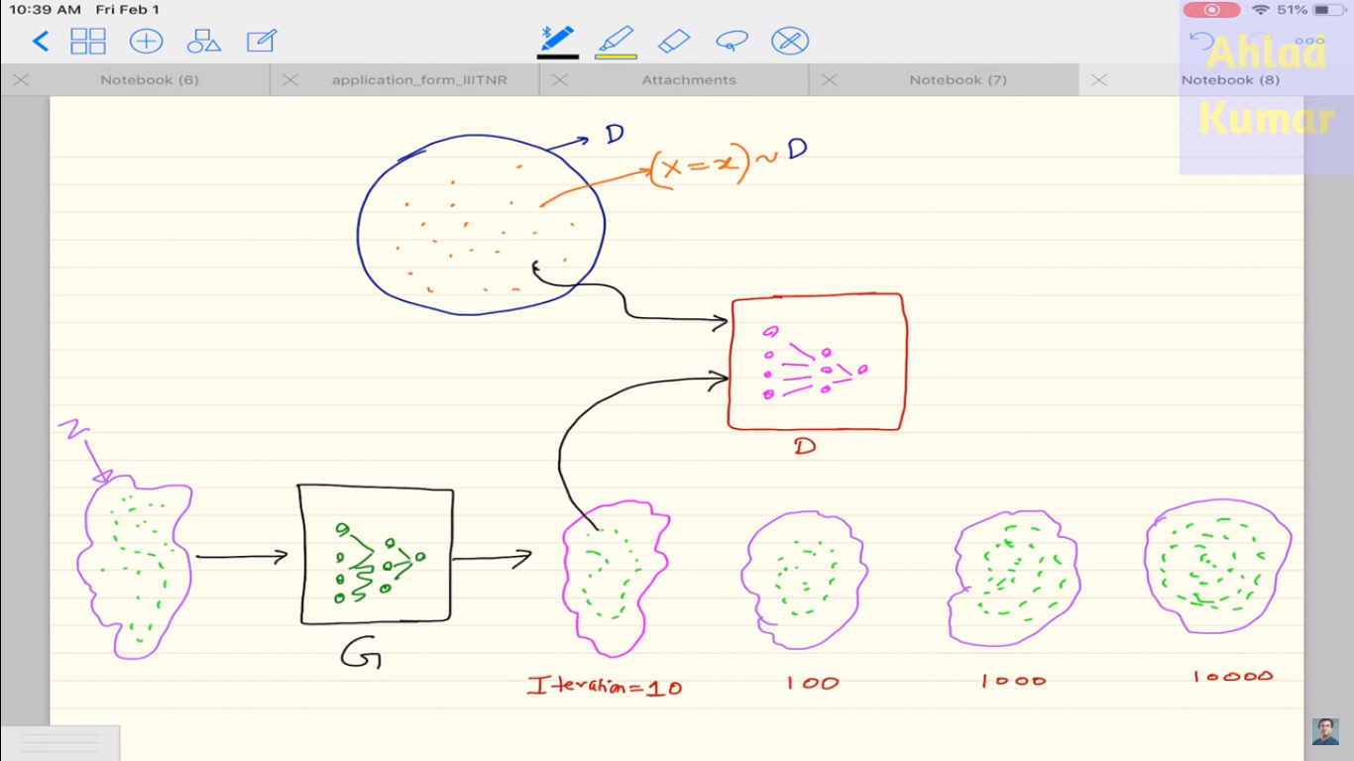

Slide 10
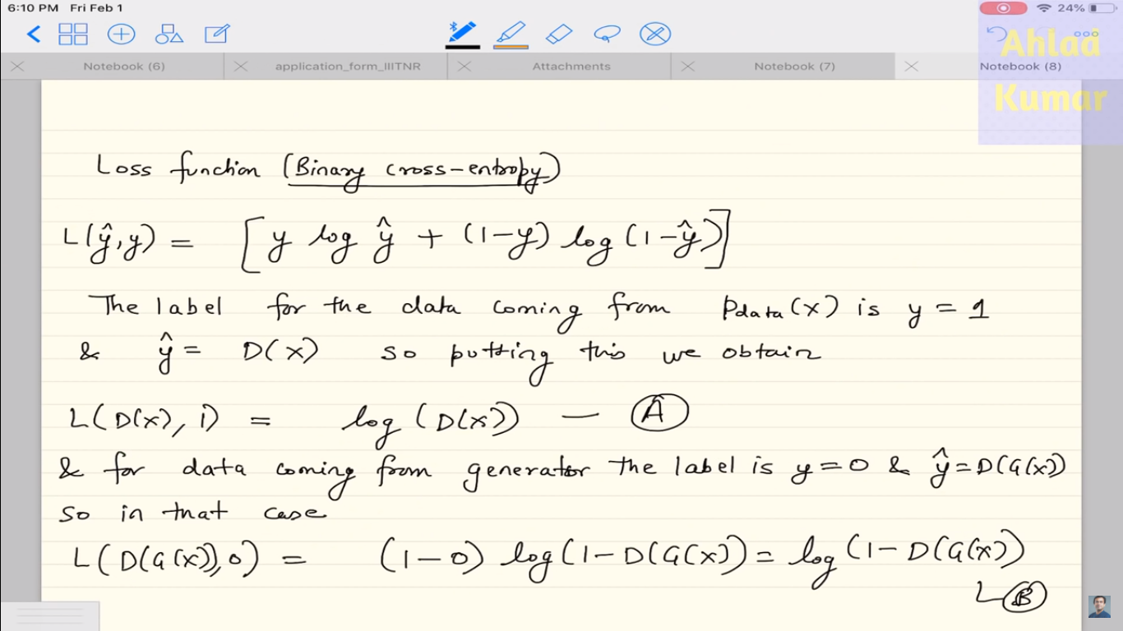

Slide 11
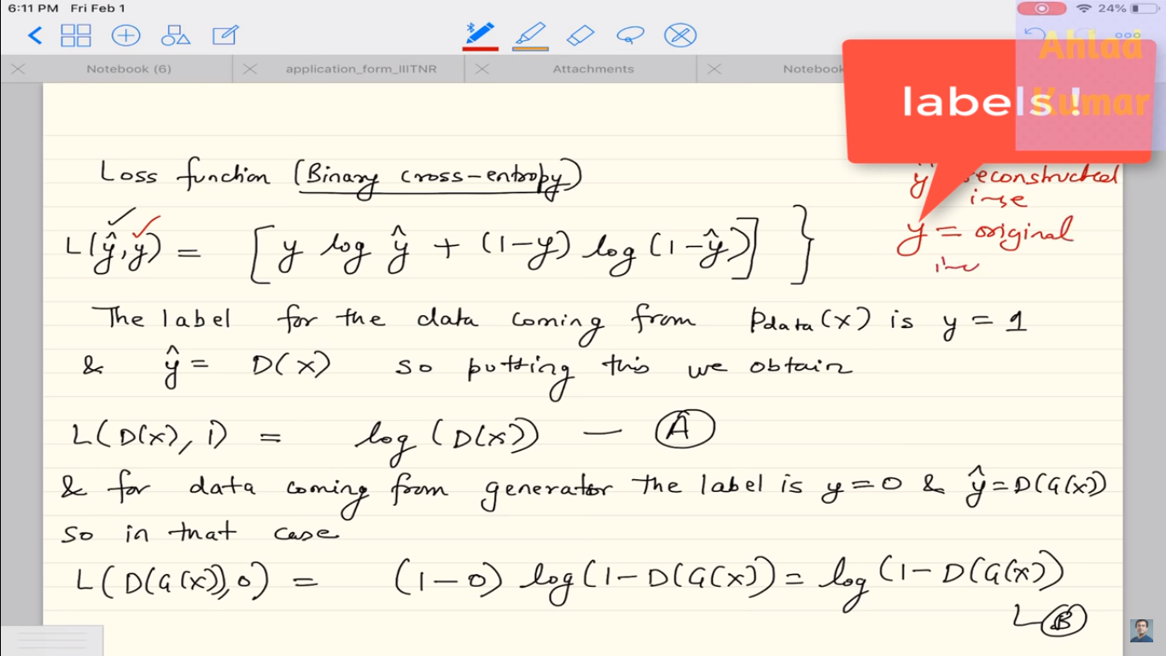

Slide 12
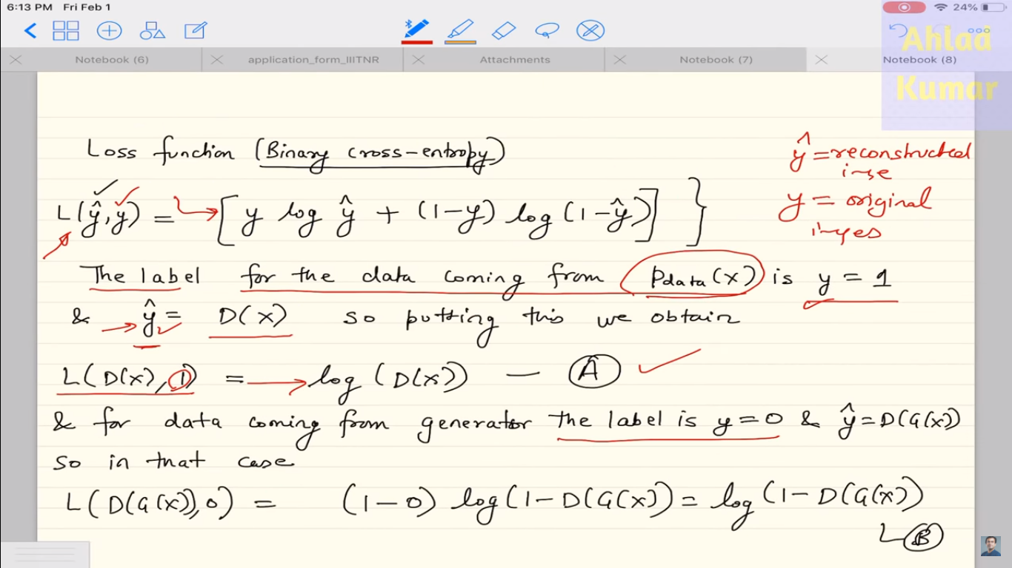

Slide 13
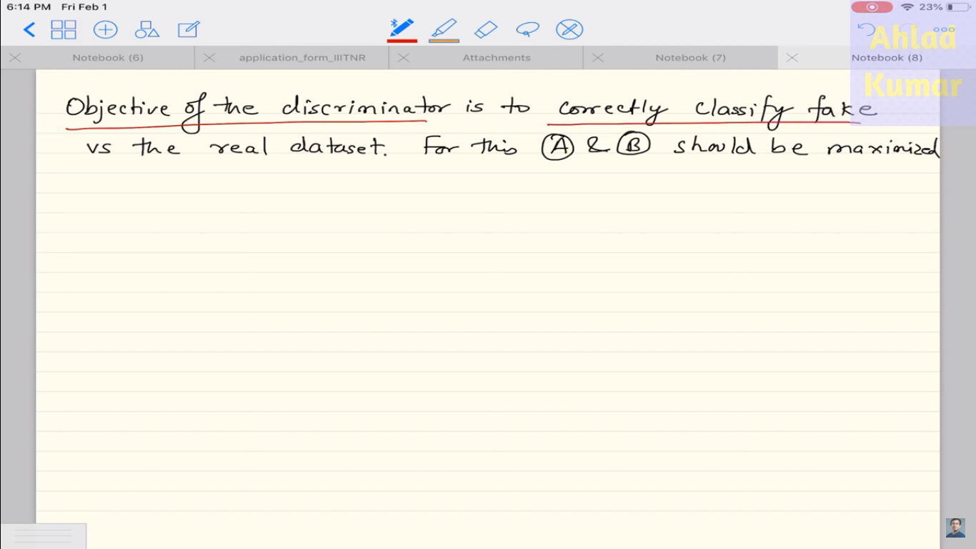

Slide 14
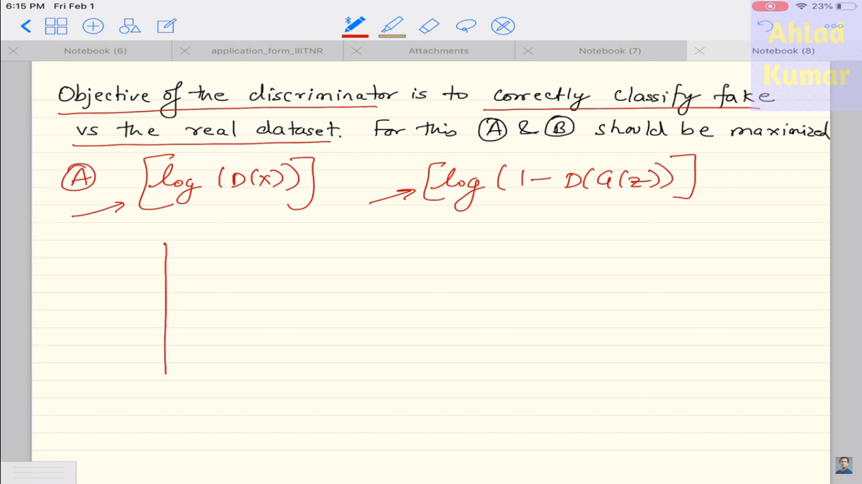

Slide 15
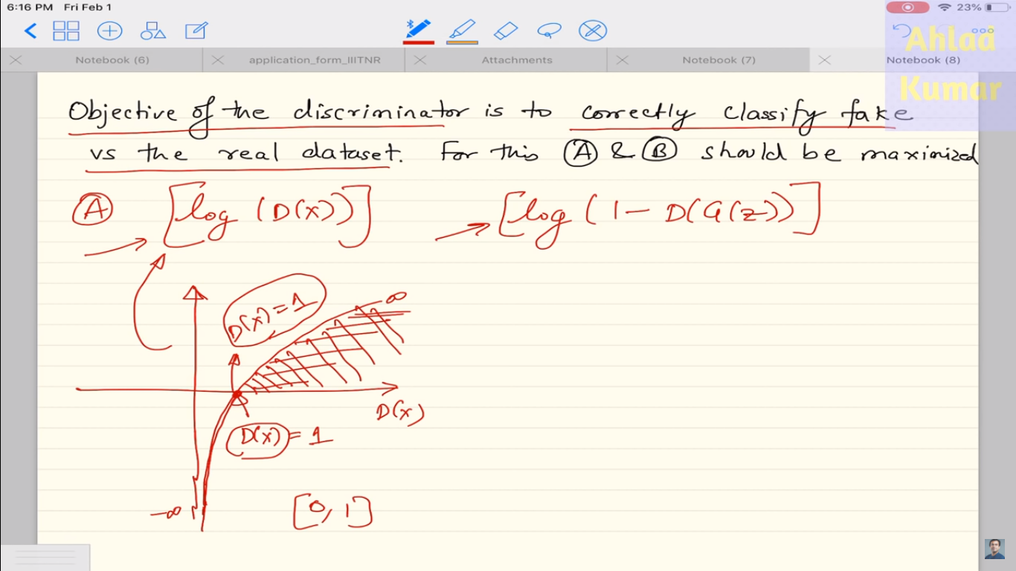

Slide 16
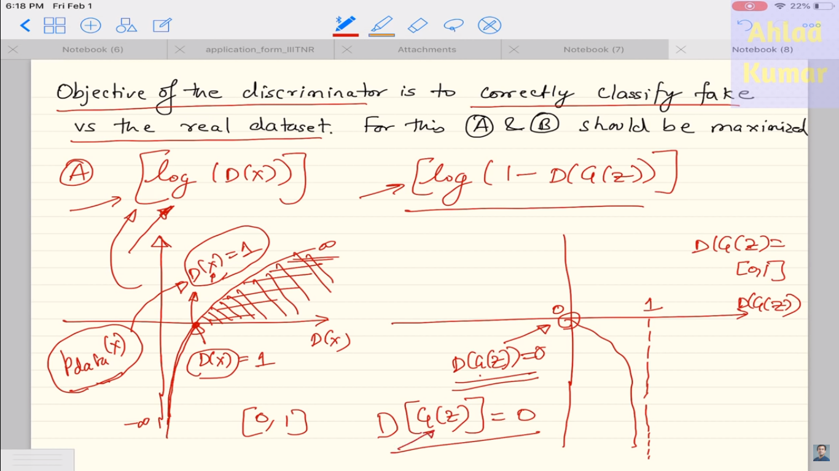

Slide 17
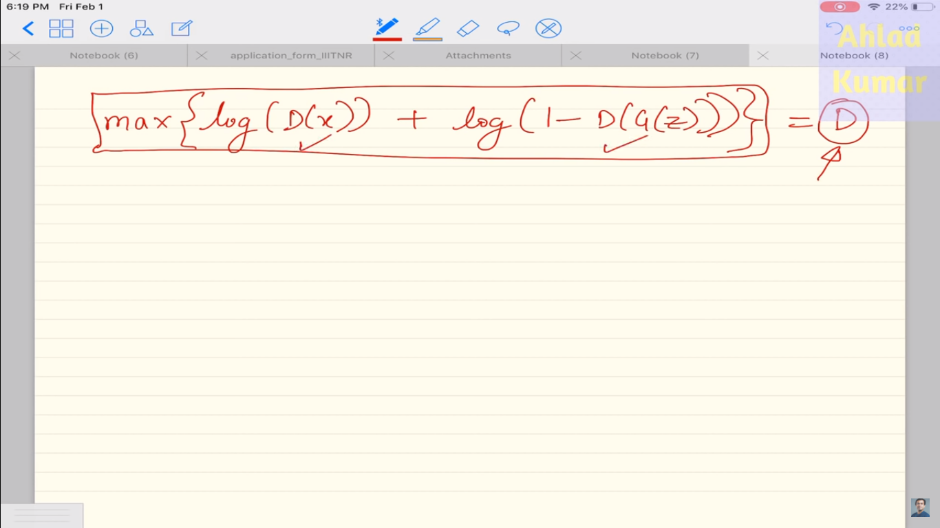

Slide 18
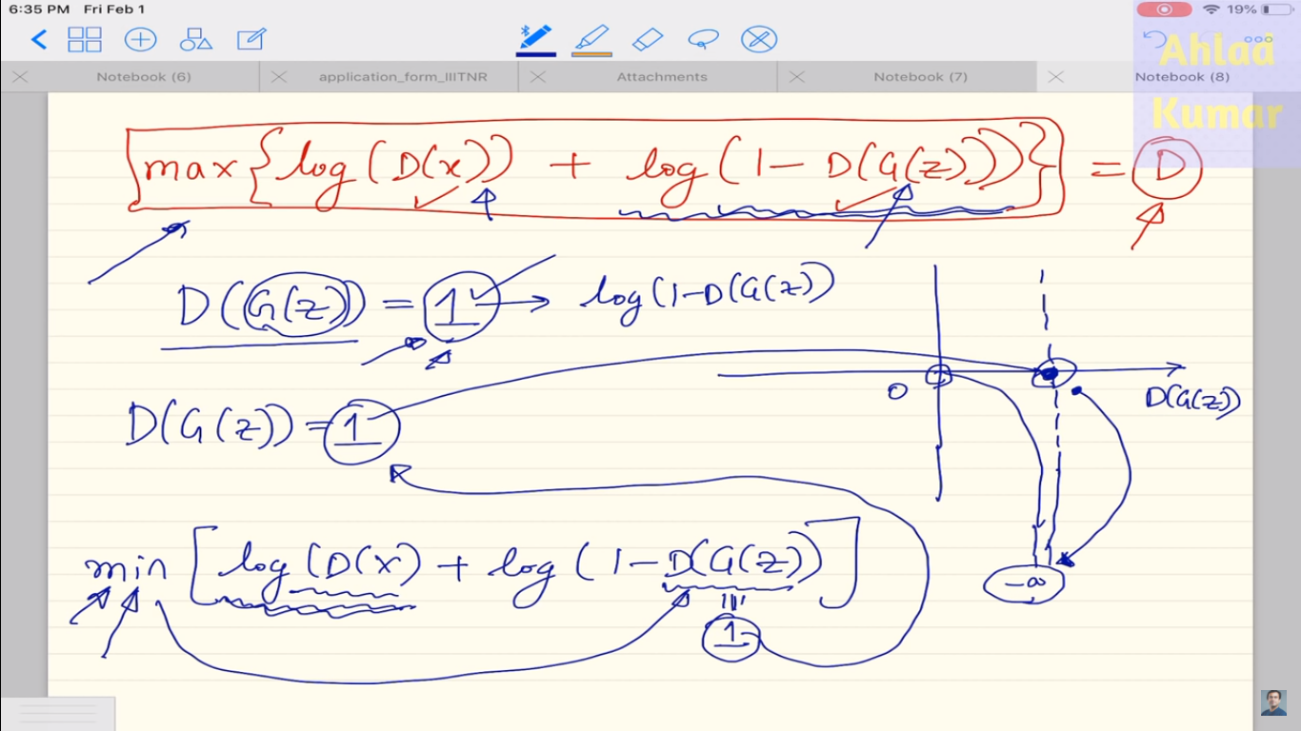

Slide 19
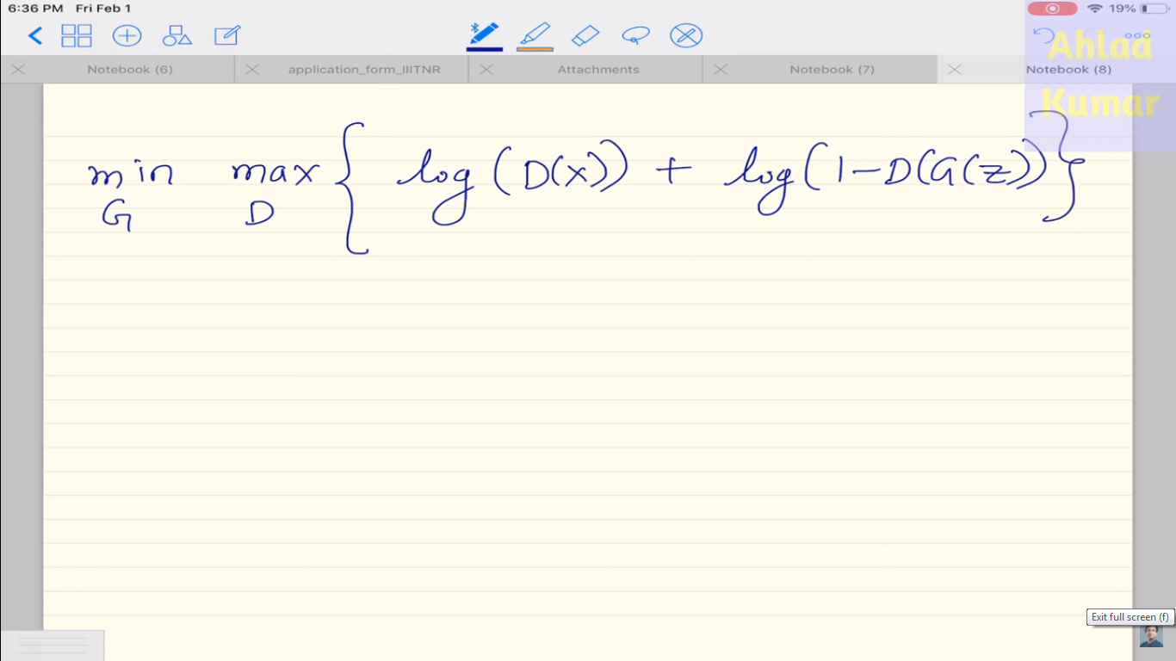

Slide 20
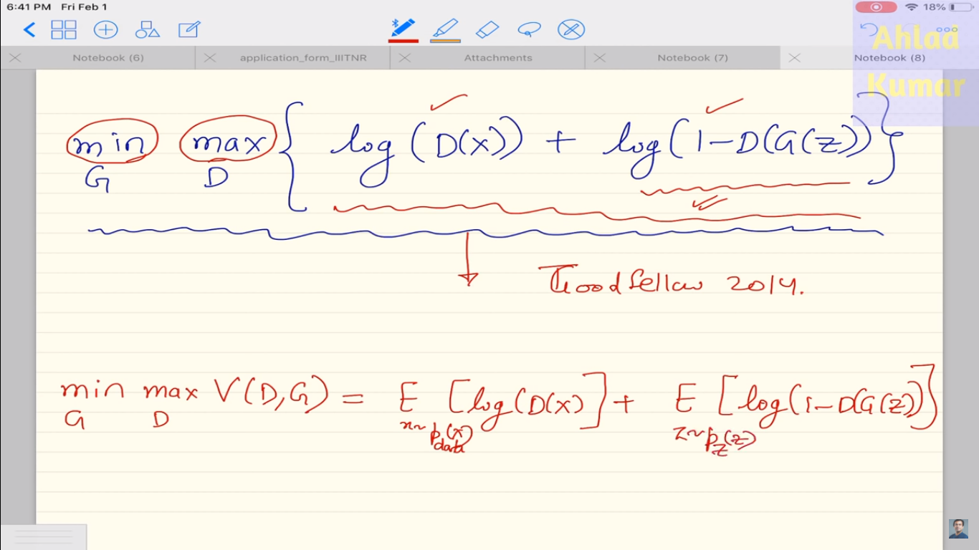

Slide 21
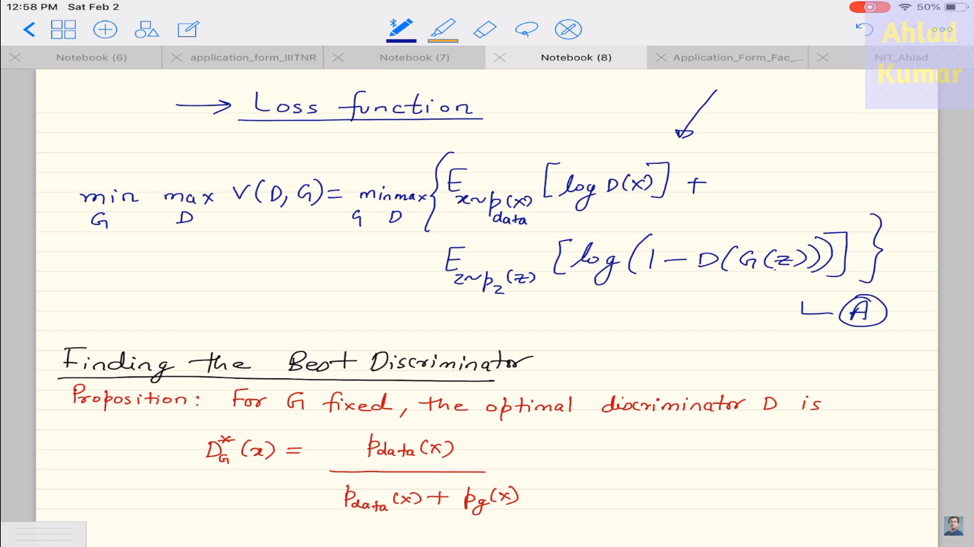

Slide 22
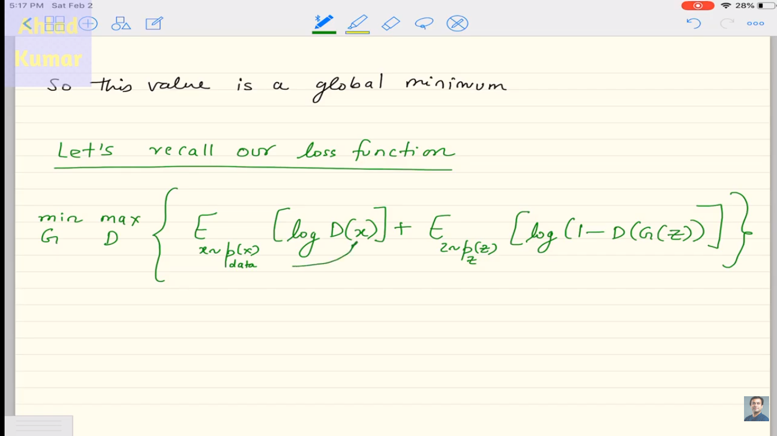

Slide 23
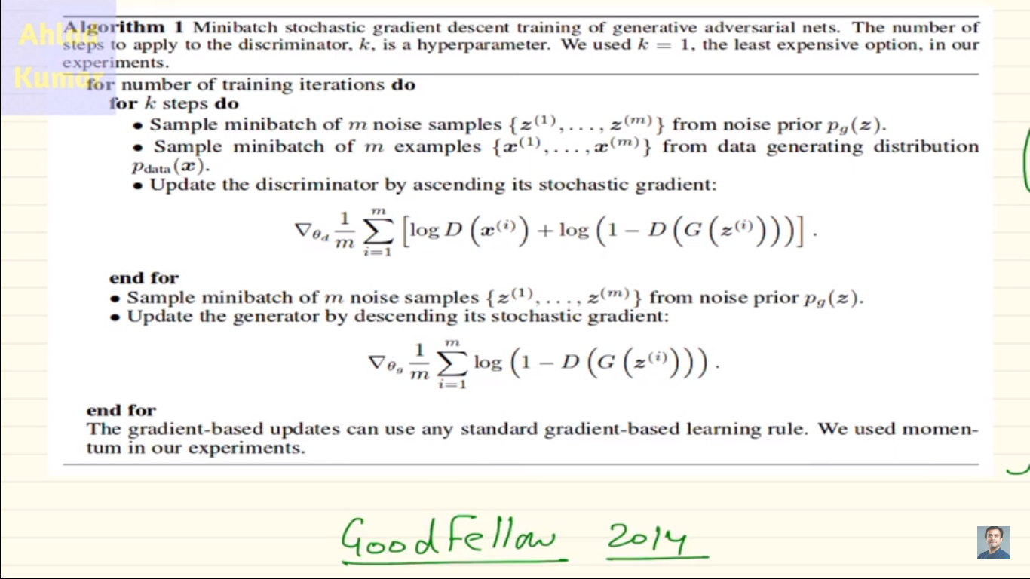

Slide 24
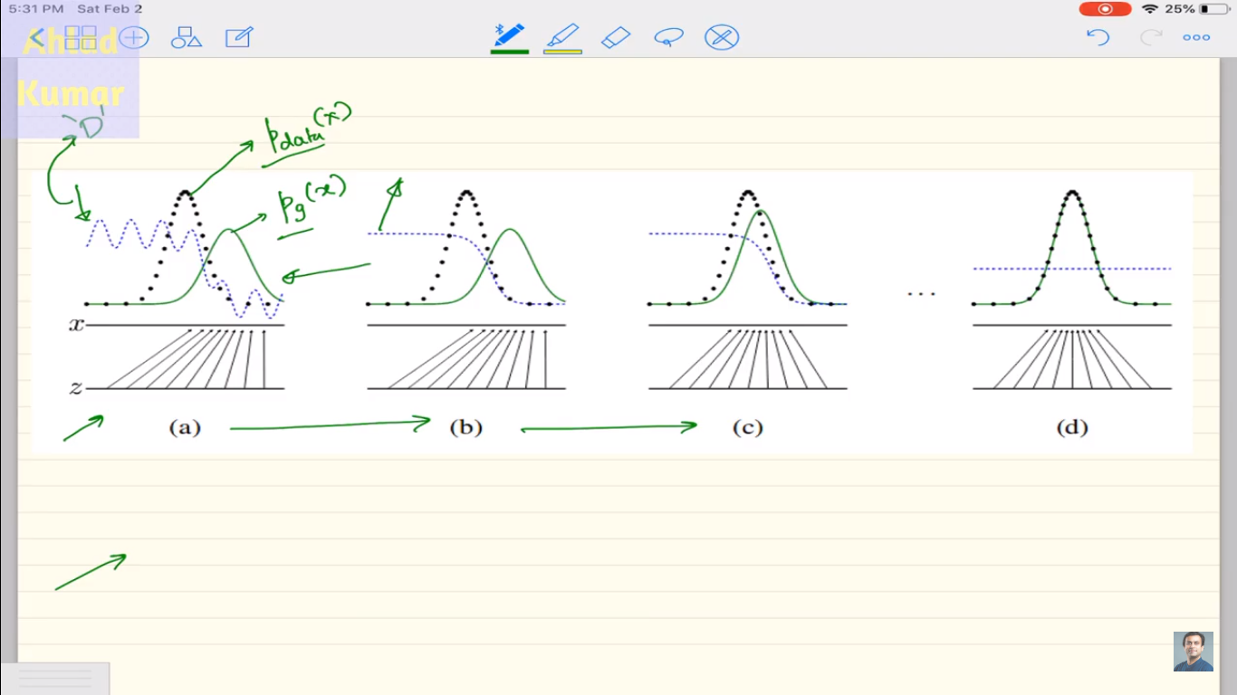

Slide 25
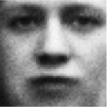
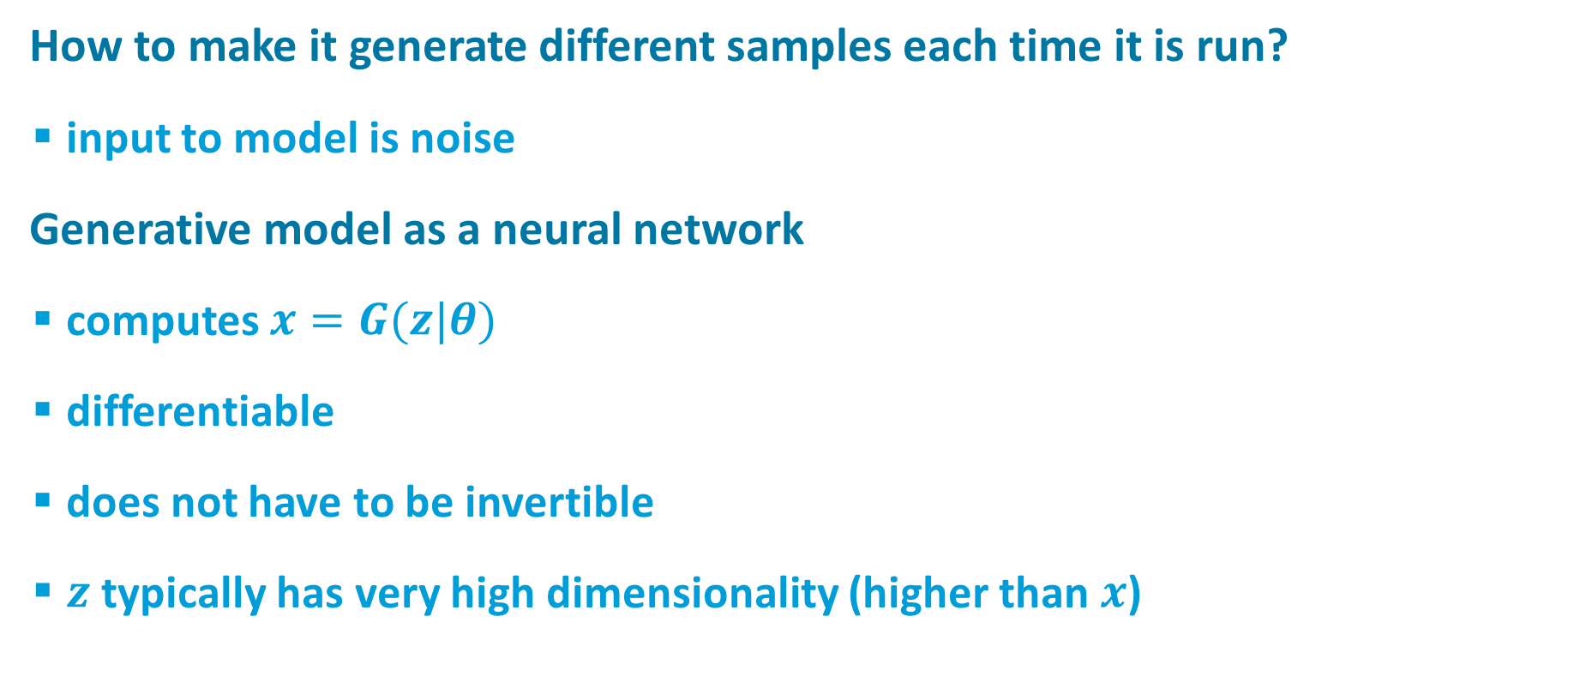

Generative Model
How to make it generate different samples each time it is run?
input to model is noise
Generative model as a neural network
computes $x=G(z|θ)$
differentiable
does not have to be invertible
$z$typically has very high dimensionality (higher than $x$)
noise ($z$)
Generative Model

Slide 26
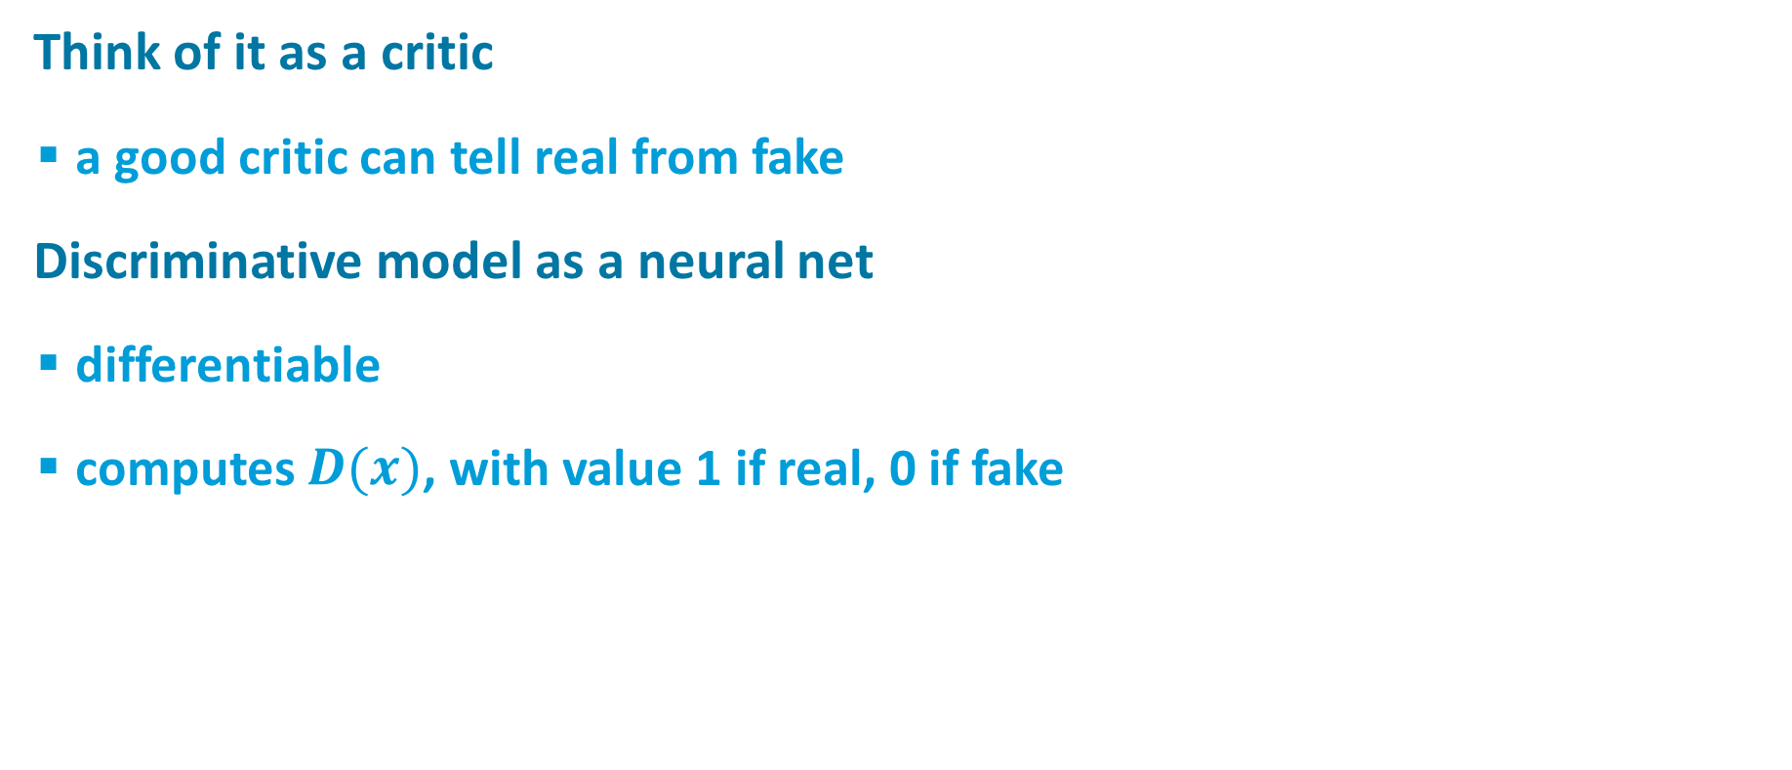
Discriminative Model
real or fake?
Think of it as a critic
a good critic can tell real from fake
Discriminative model as a neural net
differentiable
computes $D(x)$, with value 1 if real, 0 if fake
Discriminative Model

Slide 27
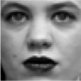

Training Procedure: Basic Idea
real or fake?
G tries to fool D
D tries not to be fooled
Models are trained simultaneously
As G gets better, D has a more challenging task
As D gets better, G has a more challenging task
Ultimately, we don’t care about the D
Its role is to force G to work harder
Discriminative Model
Real world
noise ($z$)
Generative Model

Slide 28
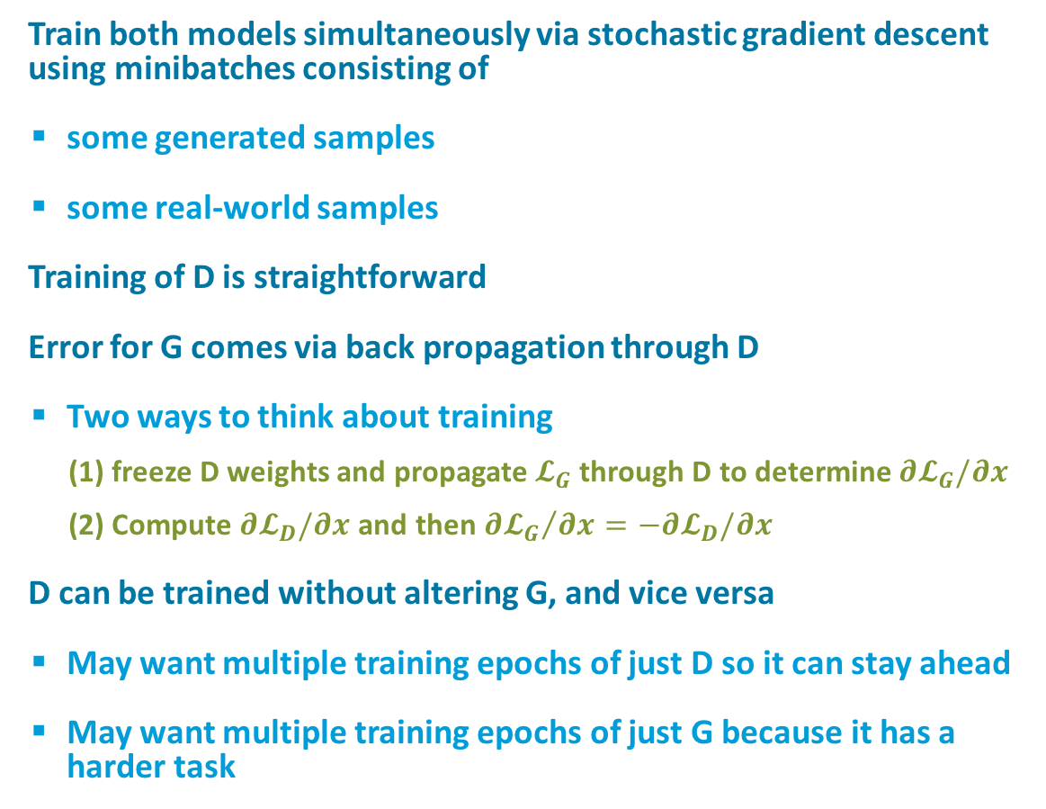
Training Procedure
real or fake?
Train both models simultaneously via stochastic gradient descent using minibatches consisting of
some generated samples
some real-world samples
Training of D is straightforward
Error for G comes via back propagation through D
Two ways to think about training
(1) freeze D weights and propagate$𝓛_{G}$ through D to determine $∂𝓛_{G}/∂x$
(2) Compute $∂𝓛_{D}/∂x$ and then ${∂𝓛_{G}}/{∂x}=−∂𝓛_{D}/∂x$
D can be trained without altering G, and vice versa
May want multiple training epochs of just D so it can stay ahead
May want multiple training epochs of just G because it has a harder task
Discriminative Model
Real world
noise ($z$)
Generative Model

Slide 29
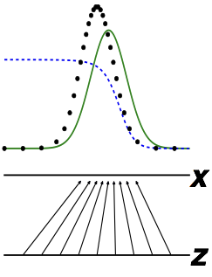
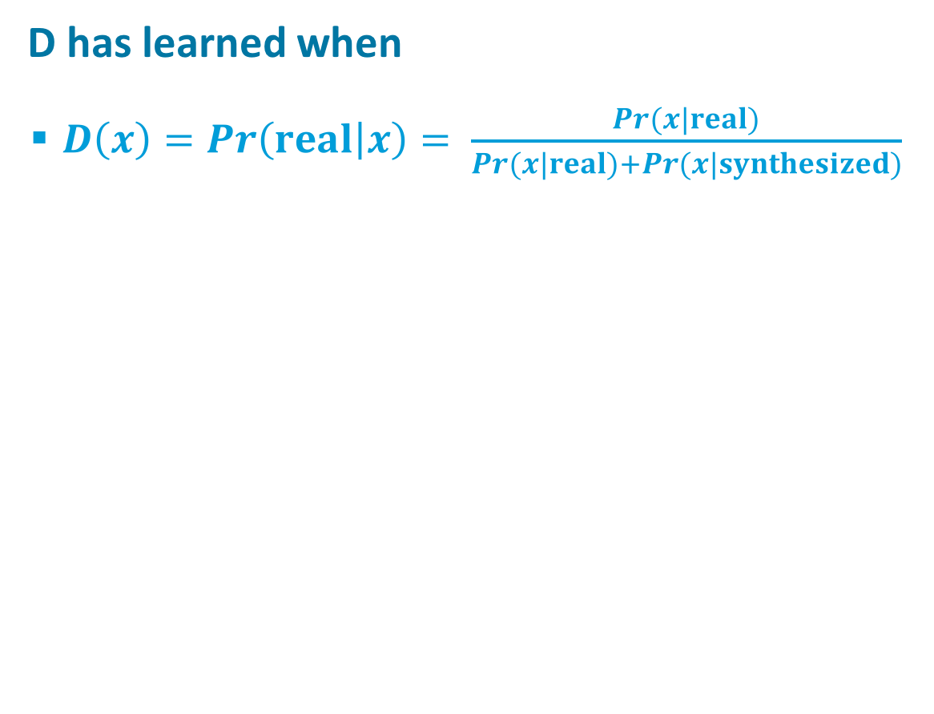
The Discriminator Has a Straightforward Task
real or fake?
D has learned when
$D\left(x\right)=Pr\left(real | x\right)= \frac{Pr(x|real)}{Pr(x|real)+Pr(x|synthesized)}$
Discriminative Model
real
discriminator
model
Real world
noise ($z$)
Generative Model
Goodfellow (2017)

Slide 30
Three Reasons That It’s a Miracle GANs Work
real or fake?
G has a reinforcement learning task
it knows when it does good (i.e., fools D) but it is not given a supervised signal
reinforcement learning is hard
back prop through D provides G with a supervised signal; the better D is, the better this signal will be
Can’t describe optimum via a single loss
Will there be an equilibrium?
D is seldom fooled
but G still learns because it gets a gradient telling it how to change in order to do better the next round.
Discriminative Model
Real world
noise ($z$)
Generative Model

Slide 31
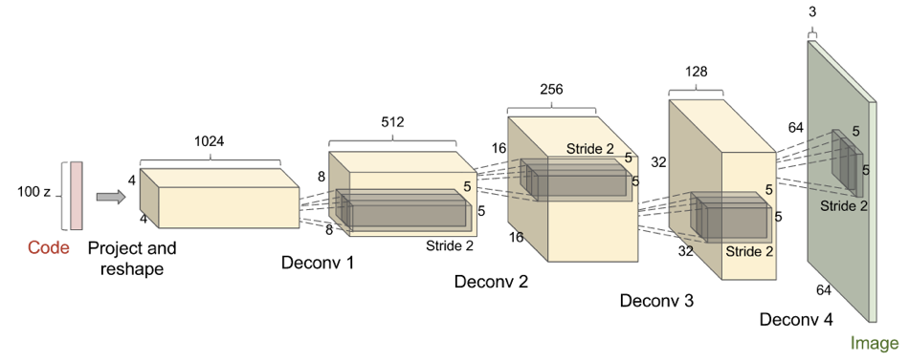
Deconvolutional GANs (DCGAN) (Radford et al., 2015)
Goodfellow (2017)
Batch normalization important here, apparently

Slide 32
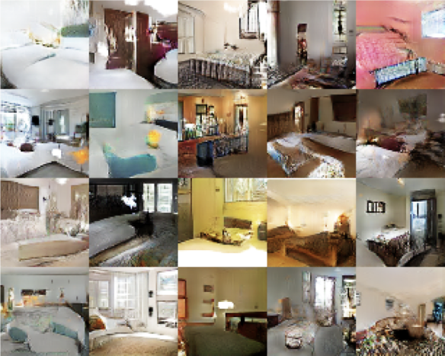
Deconvolutional GANs (DCGAN) (Radford et al., 2015)
Based on LSUN data set
10 scene categories
20 object categories
ArXiv 1506.03365
Goodfellow (2017)

Slide 33


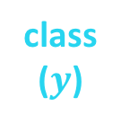
Using Labels Can Improve Generated Samples
Denton et al. (2015) Salimans et al. (2016)
real class 1
real class $n$
fake
noise ($z$)
Discriminative Model
Generative Model
class ($y$)
Notes:
GAN in lower right corner
LAPGAN next to it
6 classes from LSUN
Yellow circled images are closest real examples [to show it’s not just generating training data]

Slide 34
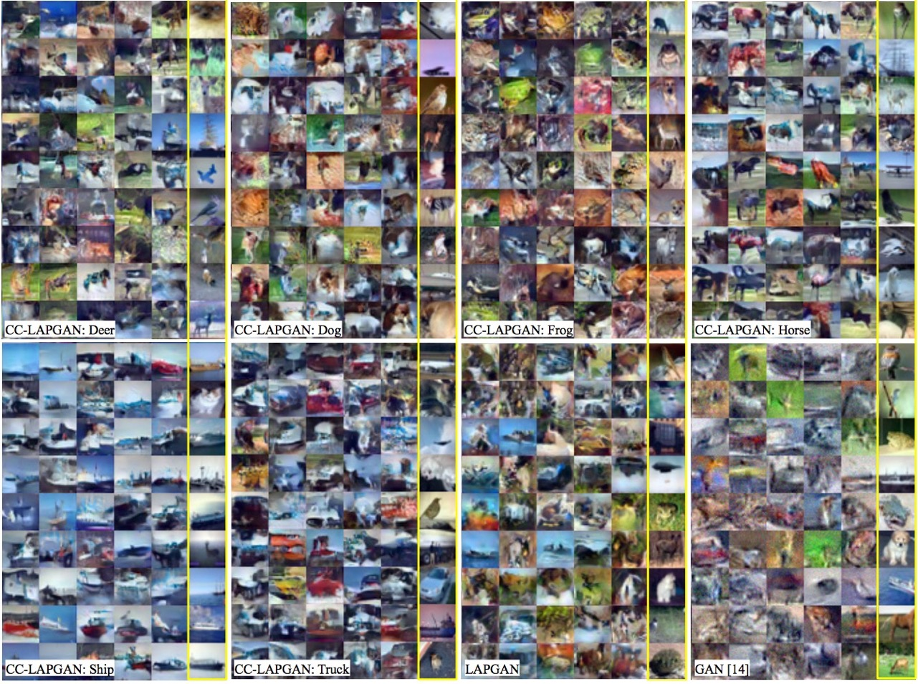
Using Labels Can Improve Generated Samples (Denton et al., 2015)
LAPGAN: multiresolution deconvolutional pyramid
CC-LAPGAN: class conditional LAPGAN
GAN: original Goodfellow model
Notes:
GAN in lower right corner
LAPGAN next to it
6 classes from LSUN
Yellow circled images are closest real examples [to show it’s not just generating training data]

Slide 35
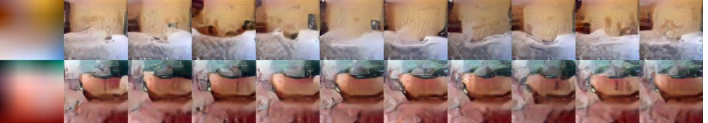
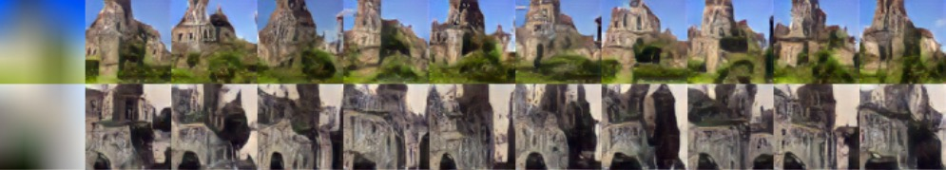
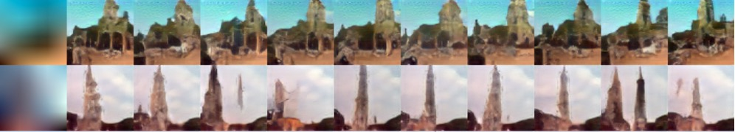
With Image Pyramid, Can Also Seed Generator With Low-Res Image + Class (Denton et al., 2015)
bedroom
church
tower
Notes:
columns are different draws

Slide 36
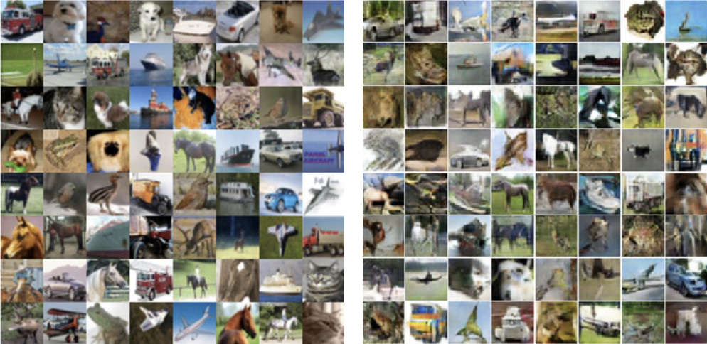
Schemes to Ensure Samples Are Diverse (Salimans et al., 2016)
Use nearest neighbor on latent representation to detect samples in a minibatch that are too similar
CIFAR training images
Synthesized images

Slide 37
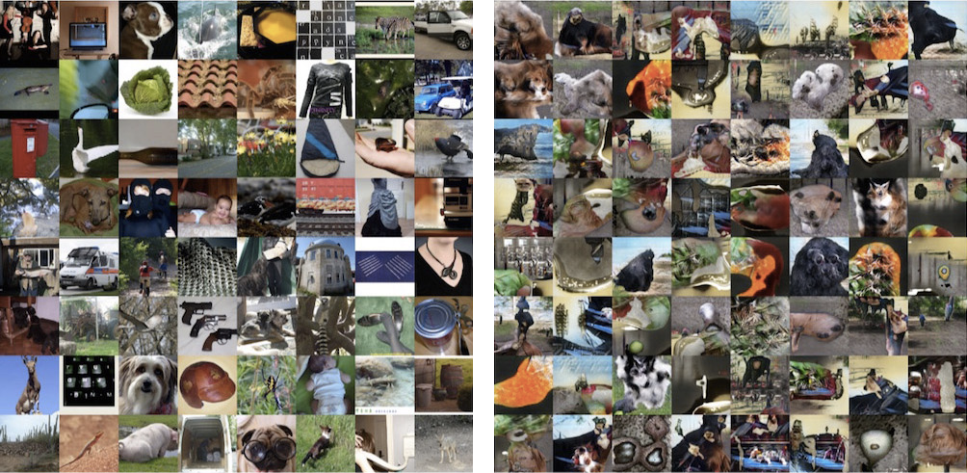
kjkjkj
ImageNet training images

Slide 38
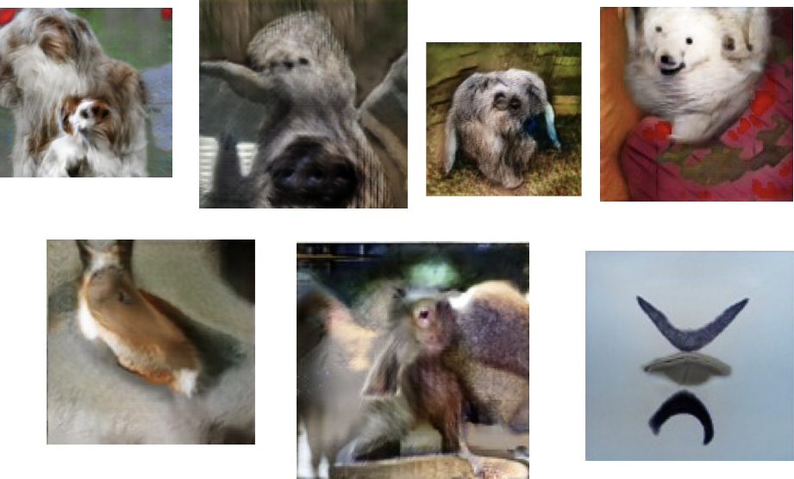
Cherry Picked Results
Goodfellow (2017)

Slide 39
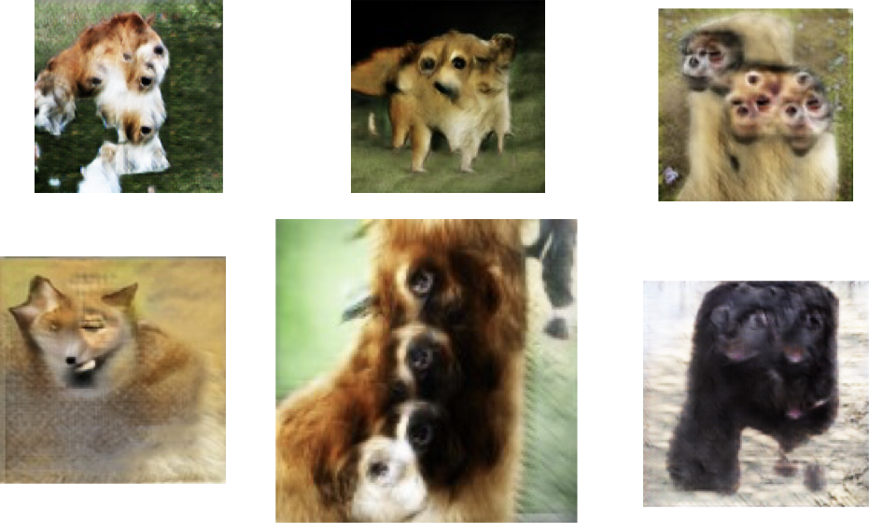
Problems With Counting
Goodfellow (2017)

Slide 40
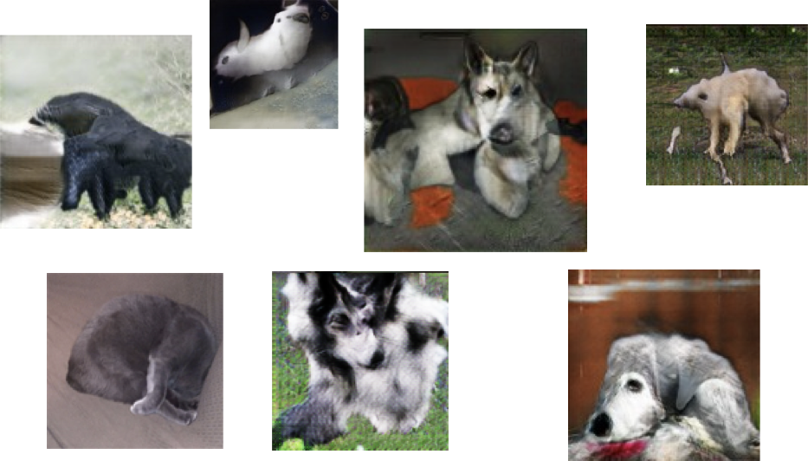
Problems With Perspective
Goodfellow (2017)

Slide 41
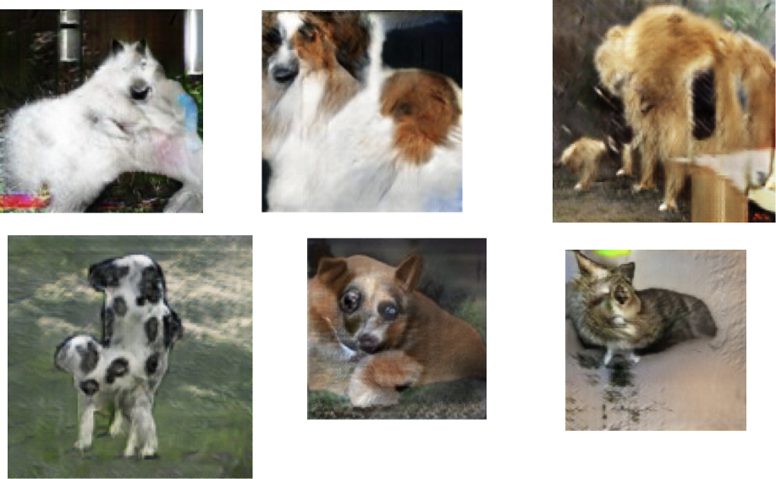
Problems With Global Structure
Goodfellow (2017)

Slide 42
Beyond Labels: Providing Images as Input to Generator: Next Video Frame Prediction (Lotter et al., 2016)
MSE tends to produce blurry images on any task
when you can’t predict well, predict the expectation
Notes:
Adversarial is sharper
What’s the architecture here? Generative model receives current frame as input (vs. random vector)

Slide 43
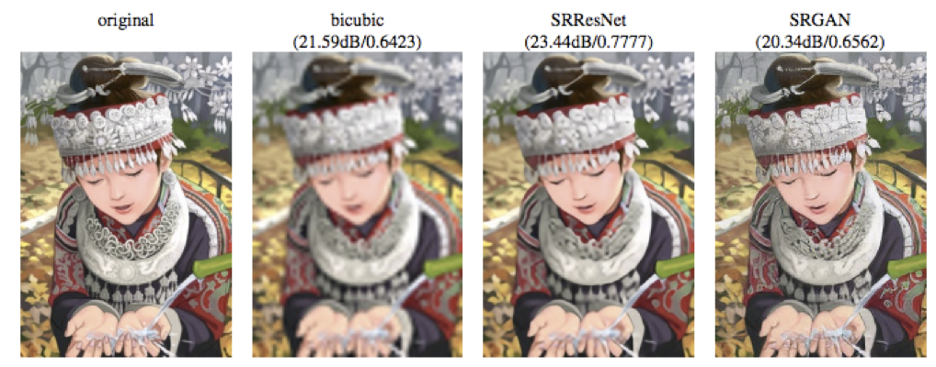
Beyond Labels: Providing Images as Input to Generator: Image Super-Resolution (Ledig et al., 2016)
Notes:
Generative model receives low res image as input

Slide 44
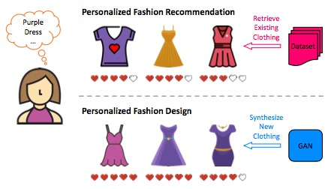
Visually-Aware Fashion Recommendation and Design With GANs (Kang et al., 2017)
Recommender systems predict how much a particular user will like a particular item
Can predict based on features of item (e.g., movie director, dress length)
Can also predict directly from images
Twist here is that instead of predicting from a predefined set, generate images that would be liked.

Slide 45
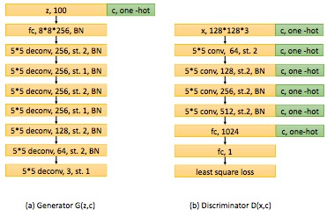
Visually-Aware Fashion Recommendation and Design With GANs (Kang et al., 2017)
Use class-conditional generator and discriminator

Slide 46
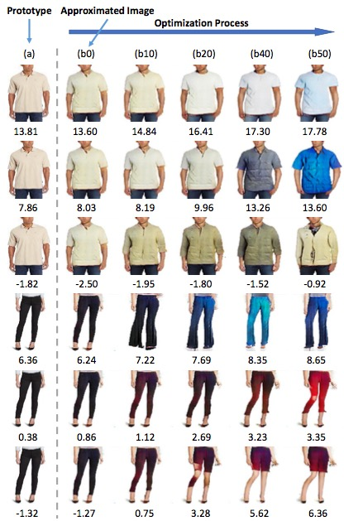
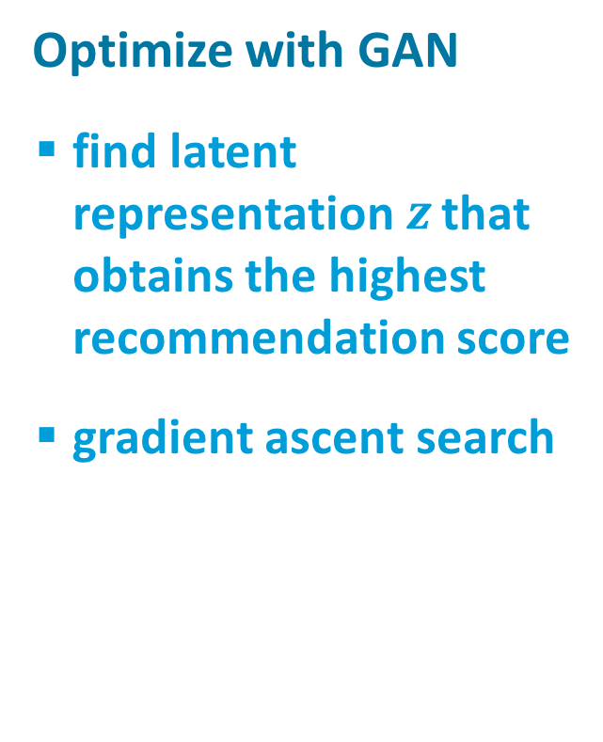
Visually-Aware Fashion Recommendation and Design With GANs (Kang et al., 2017)
Optimize with GAN
find latent representation $z$ that obtains the highest recommendation score
gradient ascent search

Slide 47
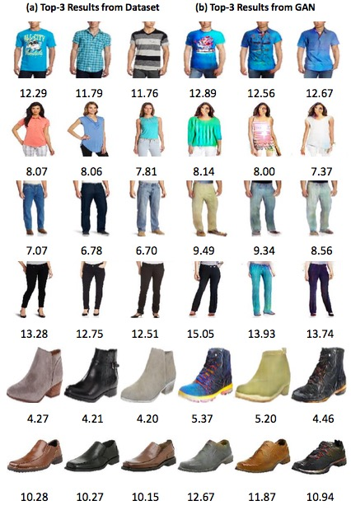

Slide 48

Cycle GANs (Zhu et al., 2017; arXiv:1703:10593v2 [cs.CV])
Given two image collections
algorithm learns to translate an image from one collection to the other
does not require corres-pondence between images

Slide 49

Photos
to paintings

Slide 50

Paintings
to photos

Slide 51


Slide 52
Star GAN
High resolution image synthesis
Notes:
https://www.theverge.com/2017/10/30/16569402/ai-generate-fake-faces-celebs-nvidia-gan
Also the new NVIDIA GAN paper seems really cool. Here's the demo vid.
https://www.youtube.com/watch?time_continue=1&v=XOxxPcy5Gr4

